Slide 1
Southampton Campus Orientation 2020
Applied Health Informatics (AHI) &
Inaugural Speech Language Pathology (SLP) Programs

Slide 2

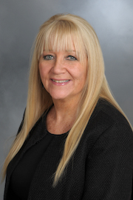
SOUTHAMPTON CAMPUS
Margaret Sheryll
Office of the Dean – Southampton Operations Coordinator
Resource and Liaison for any non-academic issues or concerns you have on campus, i.e., facilities, transportation, job opportunities, etc.
Office: New Library – Level 2 Room 208
Email: Margaret.Sheryll@Stonybrook.edu
Phone: 631-632-5131

Slide 3
SOUTHAMPTON
CAMPUS
Orientation Agenda
School of Health Technology & Management
Stony Brook Southampton
Welcome from the Dean’s Office, and SLP and AHI programs
Overview of Southampton Campus
Student and academic services
HIPAA & Compliance requirements

Slide 4
SOUTHAMPTON
CAMPUS
Orientation Introductions
Stacy Jaffee Gropack, PT., PHD., FASAHP, Dean & Professor SHTM,
Stacy.JaffeeGropack@stonybrook.edu
Karen (Kayla) Joskow Mendelsohn, MS, Assistant Dean for Academic and Student Affairs, Karen.Mendelsohn@stonybrook.edu
Renee Fabus, PhD, CCC-SLP-TSHH, Chair of the Speech-Language Pathology Chair
Hants Williams, PhD., RN- Program Director of Applied Health Informatics
Nirla Pierre, Administrative Assistant for SLP & AHI
Abigail Luizzi, Administrative Assistant Southampton Campus
Daniella Zajac, MBA, Office of Student Services, Financial Aid Information
Christian Martin, MS, CHC, Director of Health Science Schools, HIPAA & Compliance Training,

Slide 5
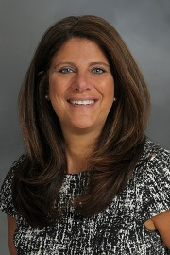
SOUTHAMPTON
CAMPUS
STACY JAFFEE GROPACK, PT., PHD., FASAHP
DEAN AND PROFESSOR
SCHOOL OF HEALTH TECHNOLOGY AND MANAGEMENT

Slide 6
SOUTHAMPTON CAMPUS
SHTM Graduate Programs
At the Southampton Campus
Doctorate in Physical Therapy – Library
Masters in Occupational Therapy – Library
Masters in Applied Health Informatics – Fine Arts
Physician Assistant – Atlantic Hall
Speech-Language Pathology - Atlantic Hall

Slide 7
SOUTHAMPTON CAMPUS
Other Southampton Campus Programs
Masters of Fine Arts
Marine and Atmospheric Sciences
Events: Grand Rounds with SBU Southampton Hospital, Pianofest, Writers Conference, Community and Cultural Events

Slide 8
SOUTHAMPTON
CAMPUS
FACILITIES AND SERVICES
IT Support – 631-632-9800
Student Center: Fitness Center, Printer, East End Cafe, Lounge, Vending, Study Space
Campus Card and ID Office
Students In Need of Computers (SINC) Sites
Theater, Lecture Hall, Access to the Shinnecock Bay at Marine Science Center
UPD, Facilities Management, Gymnasium, Newsletter
Margaret Sheryll-All campus resource

Slide 9

SOUTHAMPTON CAMPUS

Slide 10
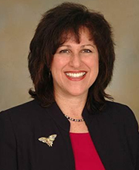
SOUTHAMPTON CAMPUS
KAREN (Kayla) JOSKOW MENDELSOHN, MS
ASSISTANT DEAN OF STUDENT AND
ACADEMIC AFFAIRS

Slide 11


Applied Health Informatics
Speech Language Pathology Orientation
School of Health Technology and Management
Southampton
Stony Brook University
Presented by Karen Joskow Mendelsohn
Assistant Dean for Academic and Student Affairs

Slide 12
STONY BROOK UNIVERSITY
West Campus
South Campus
East Campus- Health Sciences Center
Southampton Location

Slide 13
HEALTH SCIENCES CENTER
School of Medicine
School of Nursing
School of Social Welfare
School of Dental Medicine
School of Health Technology and Management

Slide 14

TEAM APPROACH TO HEALTH CARE (8 of 13)
Clinical Laboratory Scientist
Applied Health Informatics
Respiratory Therapist
Physician Assistant
Occupational Therapist
Speech Language
Pathology
Athletic Trainer
Physical Therapist

Slide 15
Health Sciences Center (HSC): Resources for Students
SOUTHAMPTON CAMPUS
HSC Office of Student Services
http://www.stonybrook.edu/hscstudents/
    Financial Aid (minimum 6 credits enrollment per term)
    Admissions
    631 444-2111
Bursar/Student Accounts
http://www.stonybrook.edu/bursar/tuition/professional/
HSC Library and Southampton Library
http://www.hsclib.sunysb.edu/

Slide 16
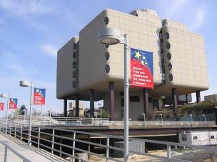
WHAT YOU NEED TO KNOW
Before Enrollment
Academic Calendar-Modules
Email accounts - you must use your
Stonybrook.edu email account
ID Badges are required
Outstanding conditions of admission- must be submitted a.s.a.p. but no later than next week
(Student Health History and Examination Forms)

Slide 17
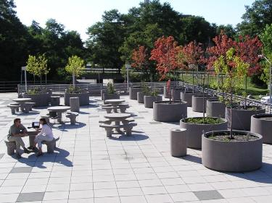
WHAT YOU NEED TO KNOW
Communication from SBU vs. SHTM
SBU- may be interesting but check with us
  SHTM-important
  AHI or SLP- important
  Graduate School- not relevant
Academic requirements
  Health Sciences Bulletin
  SHTM and Program Academic
  Policies and Procedures Handbook

Slide 18
WHAT YOU NEED TO KNOW
Americans with Disability Act
If you have a physical, psychological, medical or learning disability that may impact your course work, please contact Student Accessibility Support Center (SASC)
  They will determine what accommodations are necessary and appropriate. All information and documentation is confidential.
  Phone: (631 632-6748) Email: sasc@stonybrook.edu

Slide 19

ENROLLMENT, TUITION AND FEES
All enrollment is done via SOLAR- please be sure to click GET HELP for instructions
Students must enroll prior to the first day of the term
Refer to the Health Sciences Academic Calendar for specific enrollment dates: http://www.stonybrook.edu/commcms/hsstudents/recordsandregistration/calendars
Tuition liability: Refer to the Bursar/Student Accounts website for specific information http://www.stonybrook.edu/bursar/
Tuition and Fees: (Click tuition and fees link)

Slide 20
WHAT YOU NEED TO KNOW
TITLE IX
Policies on Non-Discrimination and Sexual Harassment
  Learning environment:
    in which a diverse population can live and work in an atmosphere of tolerance, civility and respect
    that is free from all forms of inappropriate and disrespectful conduct that may be deemed as sexual harassment
  Office of Diversity and Affirmative Action- http://www.stonybrook.edu/diversity/

Slide 21
EMERGENCY COMMUNICATION
Voice, Email and Text Messages
A mass notification system is used to provide voice, email and text messages to members of the campus community.
Log into SOLAR and use the phone and email menu selection to enter your data (If you do not provide a preferred email address the system will use your campus EPO address.)
*Please note that your wireless carrier may charge you a fee to receive messages on your wireless device.
http://www.stonybrook.edu/commcms/emergency/alerts/

Slide 22
POLICIES AND PROCEDURES – SHTM
Independent Study
Course Waivers
Challenge Exams
Academic Standing
Academic Dishonesty

Slide 23
Family Education Rights and Privacy Act (FERPA)
  FERPA- if you sign the FERPA form to withhold personal information, you will not be listed in any publications such as Commencement Programs.
  A FERPA form must be signed if you want to give us permission to speak to someone else about your records or accounts.

Slide 24
ACADEMIC INTEGRITY
Honor Code
Students are held to the highest standards as future health care team members

Slide 25

WRAP-UP
*Stay Safe and Healthy!
Congratulations and welcome to our School!

Slide 26
SOUTHAMPTON CAMPUS
DANIELLA ZAJAC, MBA
FINANCIAL AID ADVISOR
OFFICE OF STUDENT SERVICES

Slide 27
Speech Language Pathology/Applied Health Informatics
General Financial Aid Information

Slide 28



            ‘
— APPLYING FOR FINANCIAL AID—
FEDERAL AID
Fill out 2020-2021 FAFSA on FAFSA.ED.GOV
      This is how you automatically “apply” for federal loans
      Must use 2018 tax information
  REMINDER: You must complete a FAFSA every academic year
      2021-2022 FAFSA Will be available to complete on October 1, 2020
      Must use 2019 tax information
28

Slide 29
— GRADUATE STUDENTS—
            ‘
What type of federal aid can I receive?
  Federal loans:
    Eligibility: Student must be enrolled in at least 6 credits for the semester in which they would like to use federal loans
    How much?
      Unsubsidized Loan: $20,500 per academic year (Summer, Fall, Spring)
      Grad PLUS Loan: Amount will vary
        Credit check required in order to be approved
How much will it cost?
  2019-2020 NYS Summer Rate: ~$541 per credit
  2019-2020 NYS Fall/Spring Tuition Rate: $602.83 per credit
    2020-2021 Fall/Spring Tuition Rate has not yet been released
    Visit stonybrook.edu/bursar for additional information on tuition/fees
29

Slide 30
            ‘
— FEDERAL LOANS—
FEDERAL LOANS
TYPE | CAREER | ELIGIBILITY | TERMS | AMOUNT
Unsubsidized Loan | Undergraduate/ Graduate or professional students | Interest begins to accrue at the time of disbursement Interest rates may change every year and will differ for undergraduate/graduate unsubsidized loans Current interest rate = 6.08% | Loan that must be repaid with interest | Graduate: Up to $20,500
Grad PLUS Loan | Graduate or professional students | Borrower is responsible for interest during all periods; a student must be enrolled at least half-time; financial need is not required Interest rates for new Direct PLUS Loans can change every year. Current interest rate = 7.08% | Loan that must be repaid with interest Borrower must not have an adverse credit history. | Maximum amount is the cost of attendance minus any other financial aid received
30

Slide 31

            ‘
OTHER WAYS TO PAY FOR BILL
Apply for a private loan
    If you are not going to be enrolled in at least 6 credits, you may want to apply for a private loan. A list of frequently used private lenders and eligibility criteria can be found on https://www.stonybrook.edu/commcms/finaid/undergraduate/types_of_aid/private_loans
Enroll in Time Option Payment Plan (TOPP)**
    Pay one-time fee of $50 each semester that you enroll
      2 Plan Options:
      3 months
        Fall Deadline: September 15th
        Spring Deadline: February 15th
      4 months
        Fall Deadline: August 15th
        Spring Deadline: January 15th
3 Month Example
Balance = $3,000
1st Month = $1,000
2nd Month = $1,000
3rd Month = $1,000
4 Month Example
Balance = $3,000
1st Month = $750
2nd Month = $750
3rd Month = $750
4th Month = $750
** Only available for Fall/Spring
Visit https://www.stonybrook.edu/bursar for all billing information
31

Slide 32

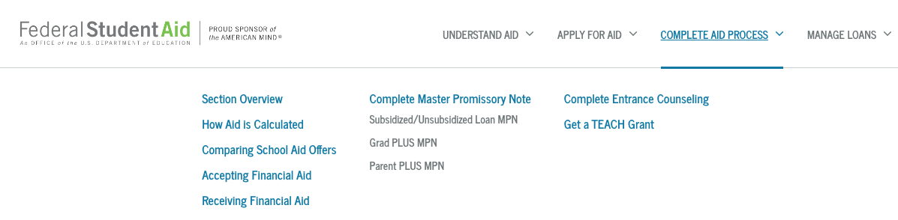
            ‘
SOLAR TO-DO ITEMS
PAY ATTENTION TO SOLAR!
On SOLAR, students will see financial aid checklists or ‘to-do’ items when there is action for them to take
  EXAMPLE: Entrance Counseling/Master Promissory Note
    In order for loans to disburse, first time borrowers will need to complete entrance counseling and master promissory note (MPN) on studentaid.gov
32

Slide 35
PLEASE NOTE: If you do not want to accept the full amount offered to you, once you press accept on the checkbox, you will then be able to delete the amount in the ‘Accepted’ box and re-enter the amount you would like. Then press submit.

Slide 36
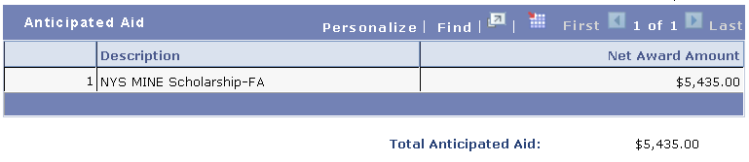

ACCEPTING AID
Once a financial aid award has been accepted, it immediately applies towards your bill as "anticipated aid”
  Anticipated Aid: Awards that you’ve accepted as part of your financial aid package and will apply to your bill to show how much you will need to pay after your anticipated aid is applied.
Grants and Scholarships are automatically accepted on your behalf as it is free money
If enrolled in at least 6 credits for Summer, loans will be offered. Be mindful of what you accept for summer as this can affect the amount of unsubsidized loans available for Fall and Spring.
EXAMPLE: Offered $12,000 in unsubsidized loan for summer, accept $8,500. Will only be offered $12,00 for Fall/Spring as you can only receive $20,500 in unsubsidized loans per academic year
    Fall/Spring awards are always split evenly
Prior to loans disbursing, students can modify amount accepted on SOLAR. After disbursement, please contact your Financial Aid office to make the change on your behalf

Slide 37

            ‘
ACCEPTING AID
If your anticipated financial aid exceeds your charges, you will be issued a refund when your aid has been applied as a payment to your University Account
  Checks are mailed out every two weeks to home address
  We strongly encourage you to enroll in direct deposit on SOLAR to receive your refund quickest!
      SOLAR > Campus Financial Services > Enroll in Direct Deposit
Students who want to cover the exact cost of their bill should factor the origination fee into the amount accepted
EXAMPLE
Origination Fee = 1.059%
Bill = $4,500
Amount Accepted (4,500 + 1.059% ) = $4,548
37

Slide 38
            ‘
Additional Questions?
Feel free to contact us!
Health Sciences Office of Student Services
Health Sciences Tower Level 2|Room 271
Stony Brook, NY 11794-8276
P: (631) 444 - 2111 | F: (631) 444 - 6035
hsstudentservices@stonybrook.edu
38

Slide 39
SOUTHAMPTON CAMPUS
CHRISTIAN MARTIN, MS, CHC
DIRECTOR OF HEALTH SCIENCE SCHOOLS COMPLIANCE
HIPAA AND CODE COMPLIANCE TRAINING

Slide 40

SOUTHAMPTON CAMPUS
SOUTHAMPTON CAMPUS

Slide 41

SOUTHAMPTON CAMPUS
Welcome 2020 Seawolves

